Slide 1
Structure Programming
ICT-1105
Information and Communication Technology
Lecture-03

Slide 2
Creating and Running Programs
There are four steps in this process.
1. Writing and editing the program using Text editor (source code).
2. Compile the program using any C compiler.(.bak file)
3. Linking the program with the required library modules(object file)
4. Executing the program. (.Exe file)

Slide 3
Creating and Running Programs
Creating and Editing a C Program in C Programming Language compiler:
Writing or creating and editing source program is a first step in c language. Source
code is written in c programming language according to the type of problem or requirement, in any text editor.

Slide 4
Creating and Running Programs
Saving C Program in C Programming Language:
Source code is saved on the secondary storage. Source code is saved as text file. The extension of file must be ".c".
Example: The file name is "learn c programming language.c"

Slide 5
Creating and Running Programs
Compiling C program in C Programming Language:
Computer does not understand c programming language. It understands only 0 and 1 means machine language. So c programming language code is converted into machine language. The process of converting source code in to machine code is called compiling.

Slide 6
Creating and Running Programs
Compiling C program in C Programming Language:
Compiler is a program that compiles source code. Compiler also detects errors in source program. If compiling is successful source program is converted into object program. Object program is saved on disk. The extension of file is ".obj"

Slide 7
Creating and Running Programs
Linking in C programming Language:
There are many built in functions available in c programming language. These functions are also called library functions. These functions are stored in different header files.

Slide 8
Creating and Running Programs
Loading program:
The process of transferring a program from secondary storage to main memory for execution is called loading a program.
A program called loader does loading.

Slide 9
Creating and Running Programs
Executing program:
Execution is the last step. In this step program starts execution. Its instructions start working and output of the program display on the screen.

Slide 10
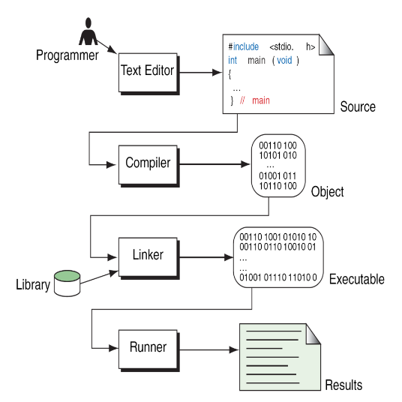
Creating and Running Programs

Slide 11
Pseudocode
An artificial and informal language that helps programmers develop algorithms. Pseudocode is very similar to everyday English.

Slide 12
Algorithm
An algorithm is a description of a procedure which terminates with a result. Algorithm is a step-by-step method of solving a problem.

Slide 13
Properties of an Algorithm
1.Finiteness:- An algorithm terminates after a finite numbers of steps.
2.Definiteness:- Each step in algorithm is unambiguous. This means that the action specified by the step cannot be interpreted (explain the meaning of) in multiple ways & can be performed without any confusion.
3.Input: - An algorithm accepts zero or more inputs.
4.Output:- An algorithm should produce at least one output.
5.Effectiveness:- It consists of basic instructions that are realizable. This means that the instructions can be performed by using the given inputs in a finite amount of time.

Slide 14
Writing an algorithm
An algorithm can be written in English, like sentences and using mathematical formulas. Sometimes algorithm written in English like language is Pseudo code.
Examples:
Finding the average of three numbers

Slide 15
Writing an algorithm
1. Let a,b,c are three integers
2. Let d is float
3. Display the message “Enter any three integers:”
4. Read three integers and stores in a,b,c
5. Compute the d = (a+b+c)/3.0
6. Display “The avg is:” , d
7. End.

Slide 16
Writing an algorithm
Example 1:
Write an algorithm to determine a student’s final grade and indicate whether it is passing or failing. The final grade is calculated as the average of four marks.

Slide 17
Writing an algorithm
Pseudocode:
Input a set of 4 marks
Calculate their average by summing and dividing by 4
if average is below 40
Print “FAIL”
else
Print “PASS”

Slide 18
Writing an algorithm
Detailed Algorithm :
Step 1: Input M1,M2,M3,M4
Step 2: GRADE ← (M1+M2+M3+M4)/4
Step 3: if (GRADE < 40) then
Print “FAIL”
else
Print “PASS”
end if

Slide 19
Flowcharts
The pictorial representation of algorithm is called flowchart.
Uses of flow chart:
1. Flow chart helps to understand the program easily.
2. As different symbols are used to specify the type of operation performed, it is easier to understand the complex programs with the help of flowcharts.

Slide 20
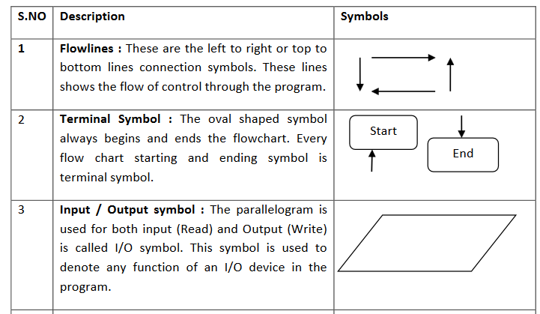
Flowchart Symbols

Slide 21
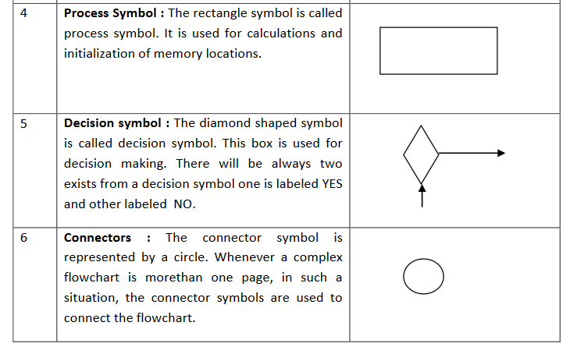
Flowchart Symbols

Slide 22
Writing an algorithm
Try yourself:
Algorithm to find whether a number even or odd

Slide 23
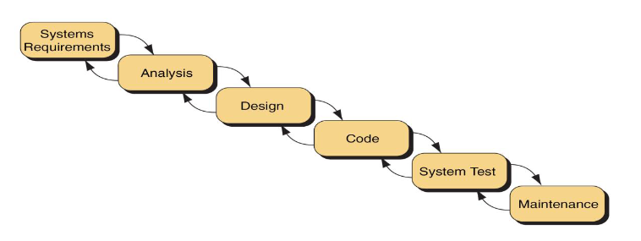
System Development

Slide 24
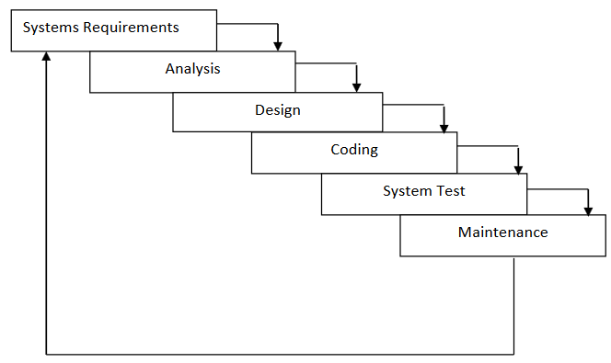
System Development

Slide 25
System Development
Statement of Problem
Working with existing system and using proper questionnaire, the problem should be explained clearly.
What inputs are available, what outputs are required and what is needed for creating workable solution, should be understood clearly

Slide 26
System Development
2. Analysis
The method of solutions to solve the problem can be identified.
We also judge that which method gives best results among different methods of solution.

Slide 27
System Development
3. Design
Algorithms and flow charts will be prepared.
Focus on data, architecture, user interfaces and program components.

Slide 28
System Development
4. System Test
The algorithms and flow charts developed in the previous steps are converted into actual programs in the high level languages like C.

Slide 29
System Development
4. System Test
a. Compilation
The process of translating the program into machine code is called as Compilation. Syntactic errors are found quickly at the time of compiling the program. These errors occur due to the usage of wrong syntaxes for the statements.
Eg: x = a * y + b
There is a syntax error in this statement, since, each and every statement in C language ends with a semicolon (;).

Slide 30
System Development
4. System Test
b. Execution
The next step is Program execution. In this phase, we may encounter two types of errors.
Runtime Errors: These errors occur during the execution of the program and terminate the program abnormally.
Logical Errors: These errors occur due to incorrect usage of the instructions in the program. These errors are neither detected during compilation or execution nor cause any stoppage to the program execution but produces incorrect output.

Slide 31
System Development
5. Maintenance
We are maintenance the software by updating the information, providing the security and license for the software.

Slide 32
Thank you….

